Slide 1
MIP 2022-2 by Y. K. Kim 2022.08.11
XT-32 Environment, Blensor Simulation, and 3D Detection Model
한동대학교 기계제어공학부
21700421 ChangMin An

Slide 2
XT-32 Pre-Processing
Visualization
Blensor 3D Modeling
3D Object Detection Model
Contents

Slide 3
XT-32 Pre-Processing
Procedure
XT-32 PCAP Format -> PCD (MATLAB 2022a)
PCD -> bin (Python 2.7, Ubuntu 20.04)

Slide 4
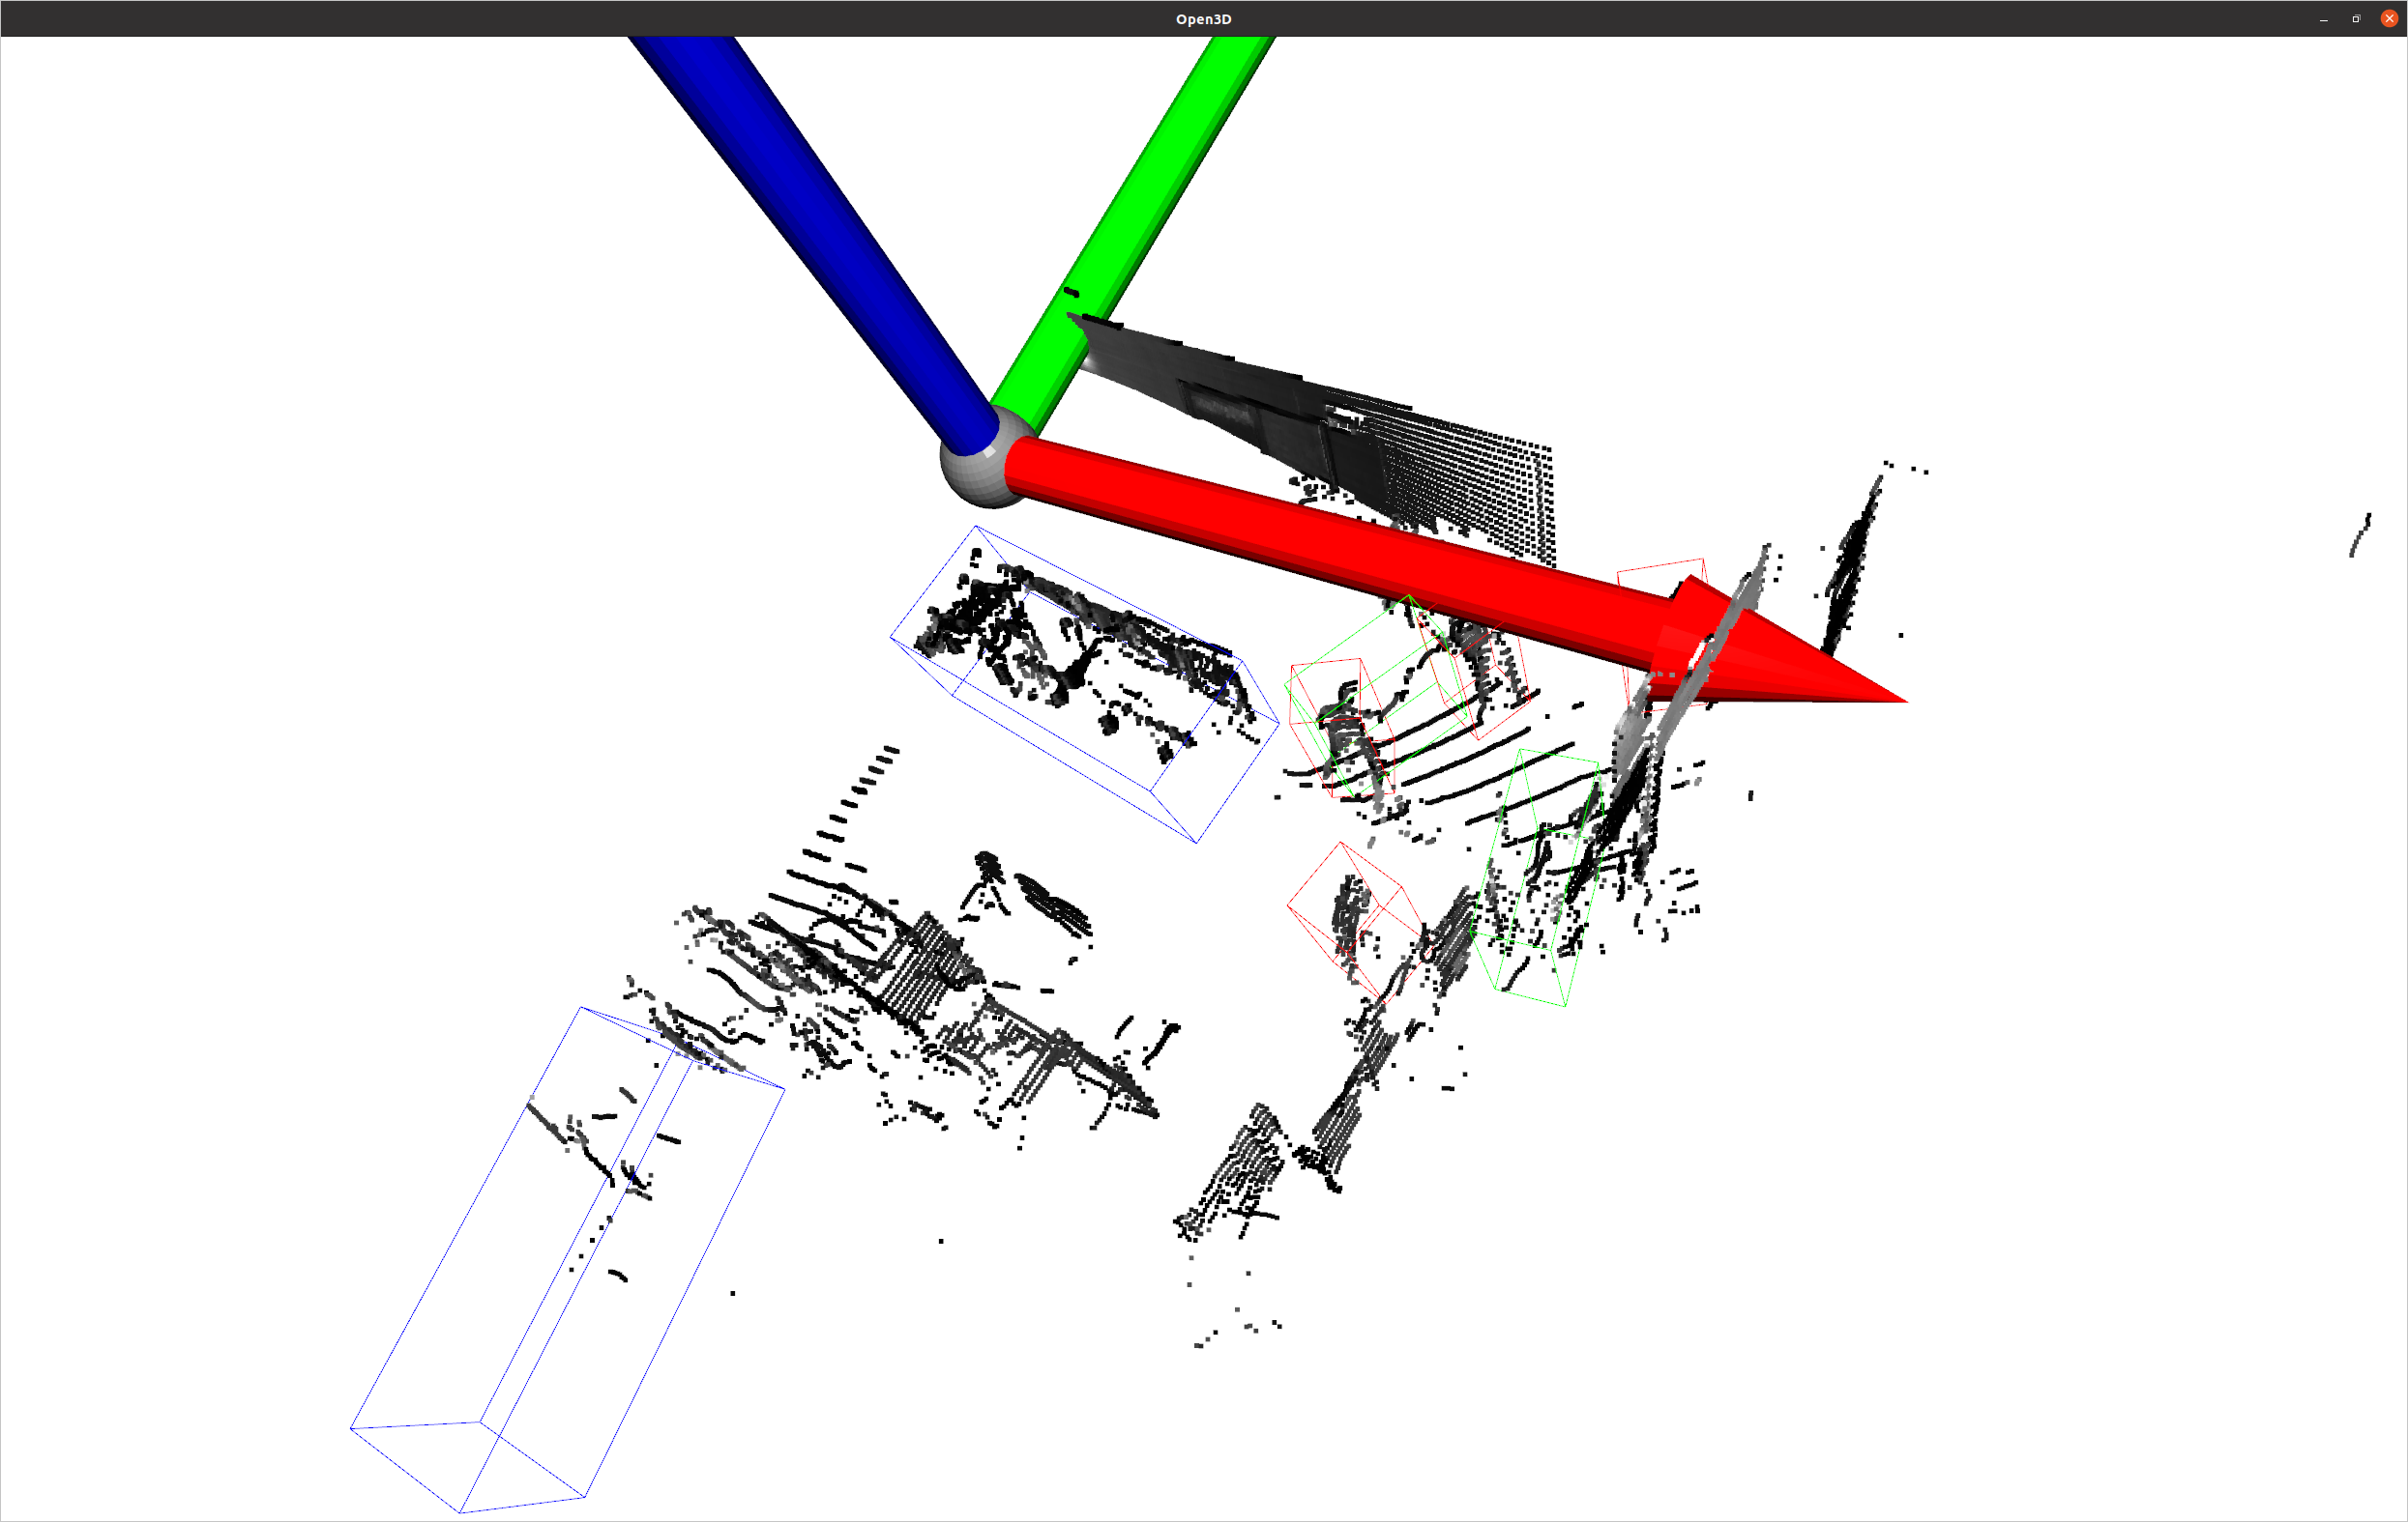
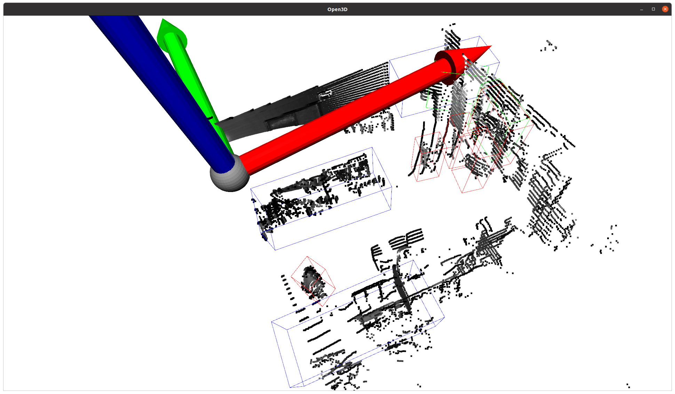
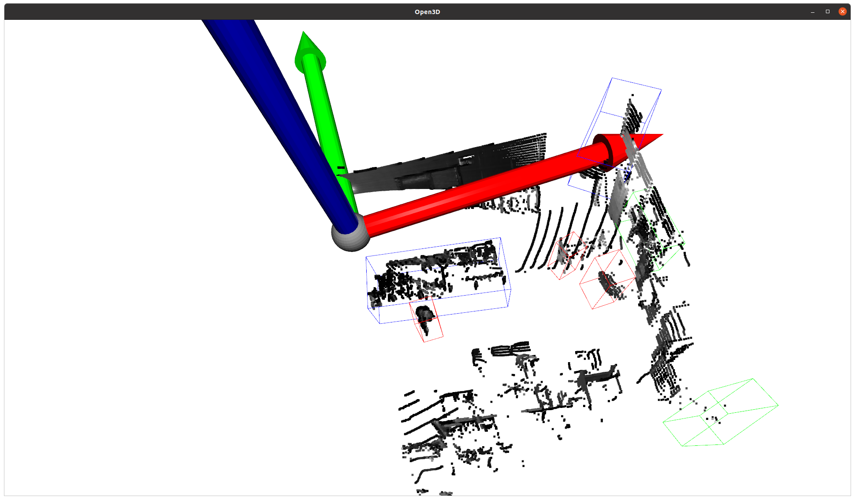
Visualization
Frame 310
Frame 400
Frame 120
Pedestrian
Cyclist
Car

Slide 5
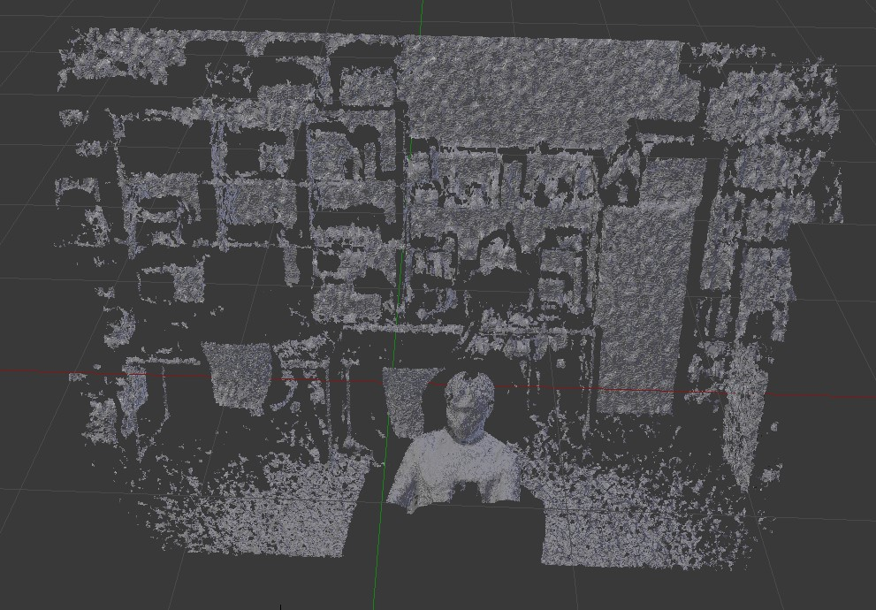
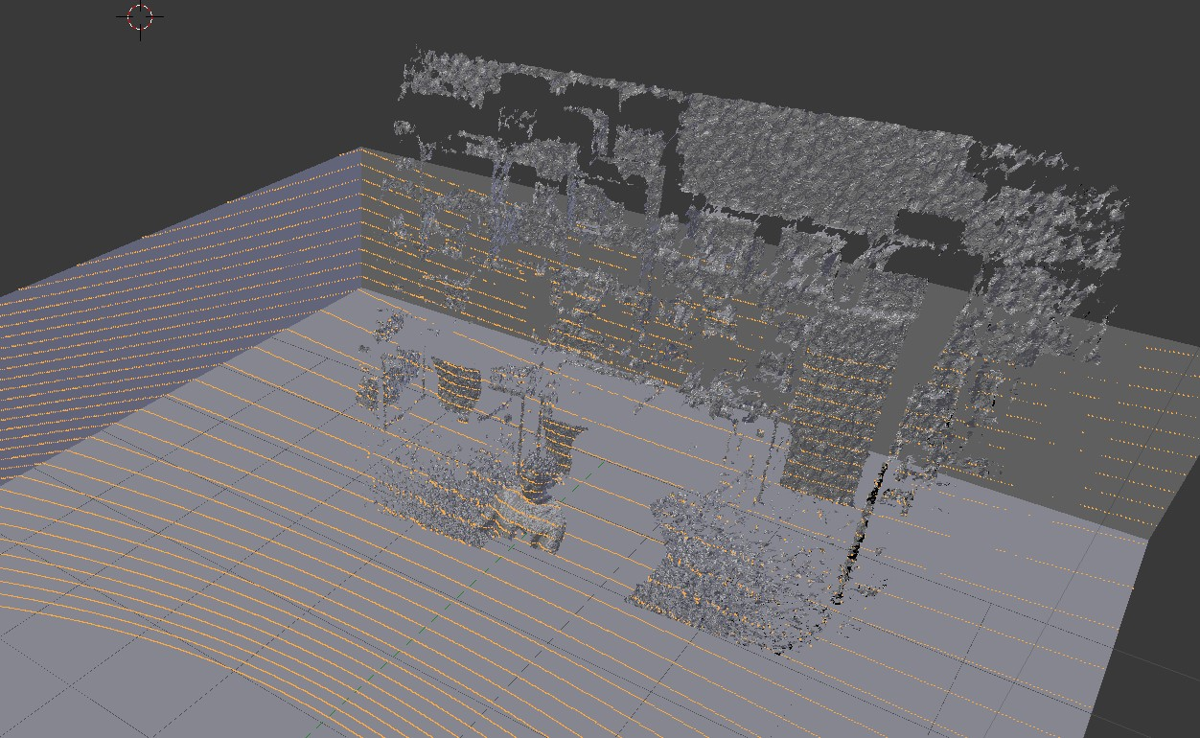
Blensor 3D Modeling

Slide 6
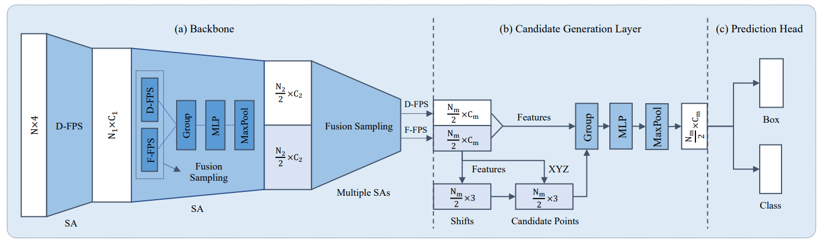
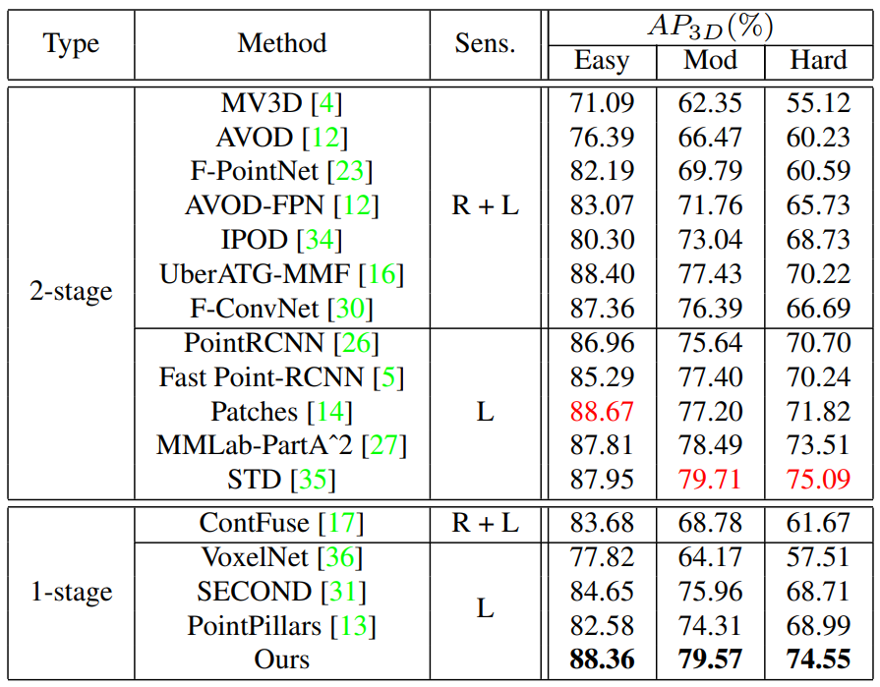
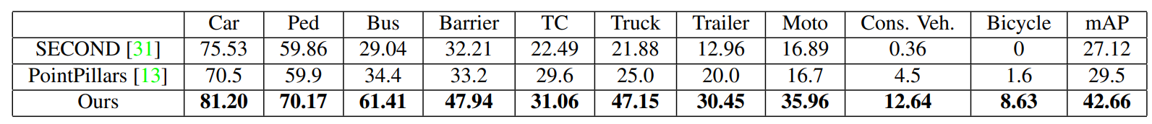
3D Object Detection Model
3DSSD: Point-based 3D Single Stage Object Detector (2020.02)

Slide 7
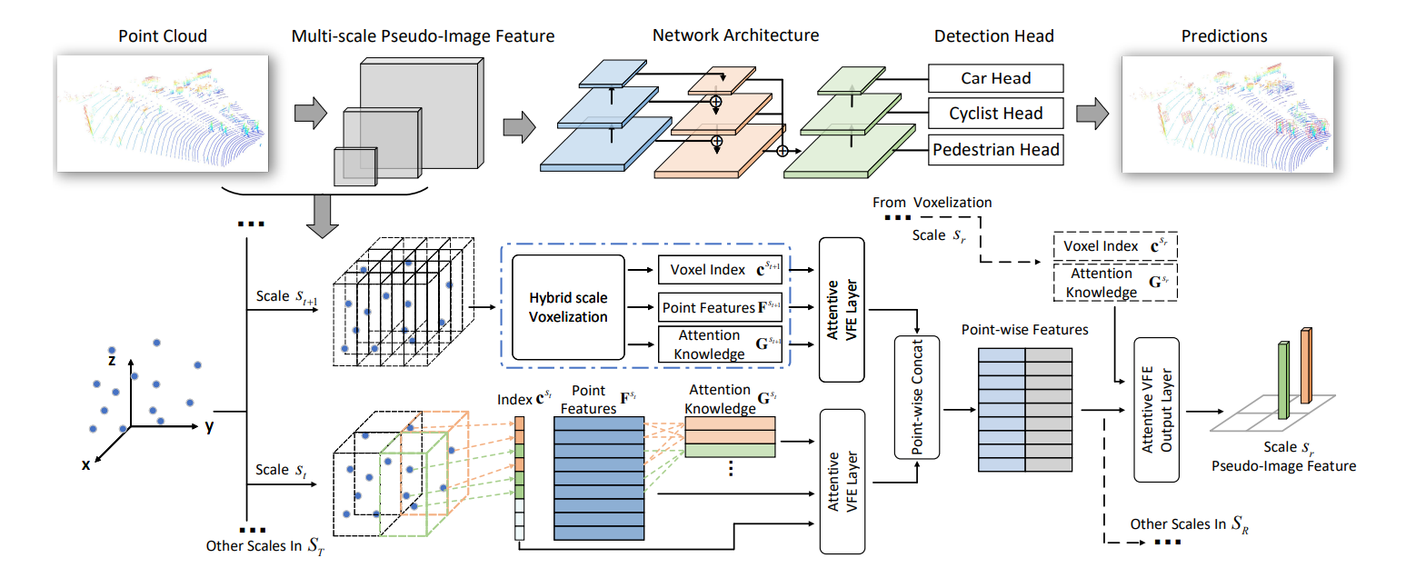
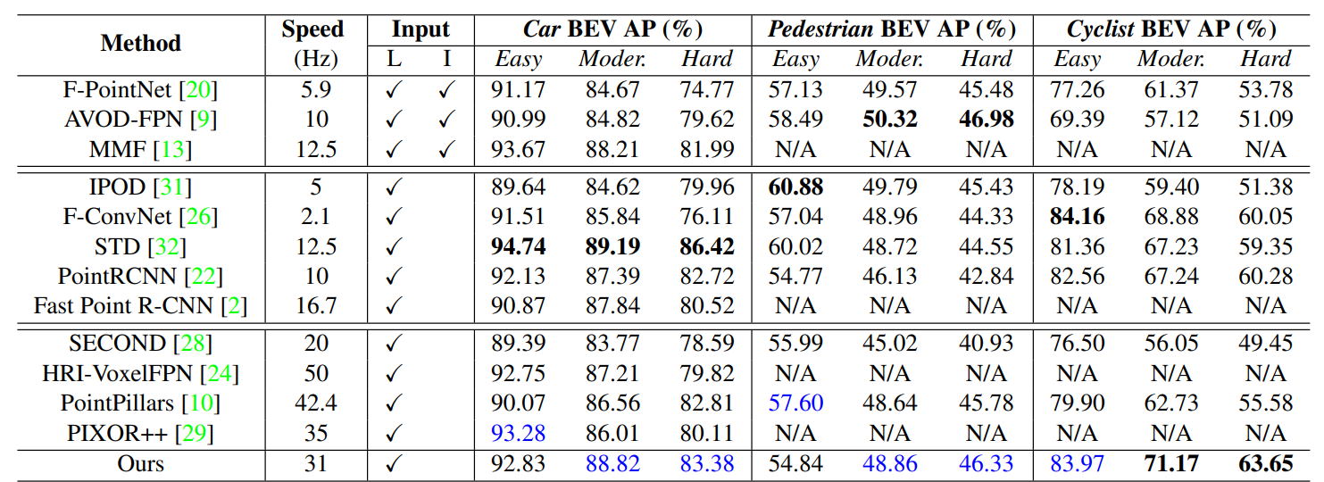
3D Object Detection Model
HVNet: Hybrid Voxel Network for LiDAR Based 3D Object Detection (2020.03)

Slide 8
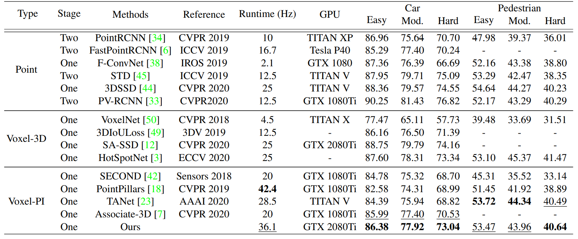
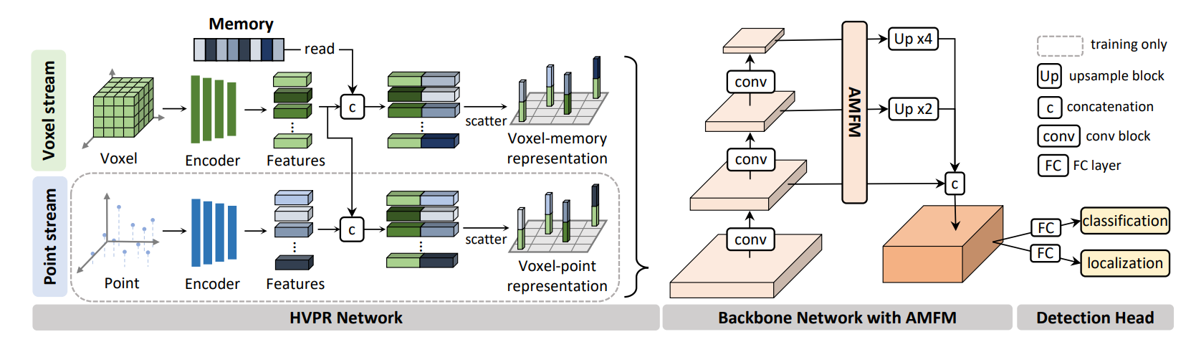
3D Object Detection Model
HVPR: Hybrid Voxel-Point Representation for Single-stage 3D Object Detection (2021.04)

Slide 9
3D Object Detection Model
Type | Stage | Method | RunTime(Hz)
Point | One | 3DSSD | 25
Voxel-PI (Pseudo Image) |  | SECOND | 20
 |  | PointPillars | 42.4
 |  | HVNet | 31
 |  | HVPR | 36.1
Running Time: PointPillars > HVPR > HVNet > 3DSSD
Performance: 3DSSD > HVPR > HVNet >= PointPillars

Slide 10
Reference
Zetong Yang, Yanan Sun, Shu Liu, and Jiaya Jia. 3DSSD: Point-based 3D Single Stage Object Detector. In CVPR, 2020.2, https://arxiv.org/pdf/2002.10187.pdf
Maosheng Ye, Shuangjie Xu, and Tongyi Cao. HVNet: Hybrid Voxel Network for LiDAR Based 3D Object Detection. In CVPR,

